Slide 1

Business Event Management System Project Presentation session 2019-20
Industrial training (BCA551)
Degree : BCA
Project Guide:
Mr. Ajay Rastogi sir
Mrs. Swathi Vishnoi ma’am
Group
Sudhanshu Rajput(TCA1701046)
Vishal Shivayach (TCA1701015)
Hrithik Kumar(TCA1701325)
COLLEGE OF COMPUTING SCIENCES AND INFORMATION TECHNOLOGY
TEERTHANKER MAHAVEER UNIVERSITY, MORADABAD

Slide 2

Project Brief
This project stores the information and data into a data base. And this Business Event Management System focus on the improvement of an information system that will store all information related to prospects and business partners. This project will help the user in easy sorting of data according to any requirement of the user.
This software can also generate the user specialized reports based on business data.
Guidelines: Mention brief about the project and it’s modules
2
BEMS/ Version 1.0

Slide 3
Technologies and Tools to be used
Software Platform:
Front-end:
In front-end we use Visual Studio 2012.
OS - Windows.
Back-end:
Microsoft office access database (2007).
Tools:
Visual Studio 2010/2012
Database (Microsoft office access 2007)
Guidelines: Mention Front End, Back End, Tools (if any)
3
BEMS/ Version 1.0

Slide 4

Data Flow Diagram (DFD)
Guidelines: Add more slides, if required to show all DFDs
4

Slide 5

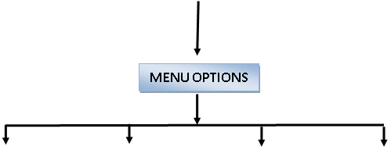


Flow Chart
File
New Entry
View /update
View Reports
Reports Generated
Guidelines: This slide is optional
5

Slide 6
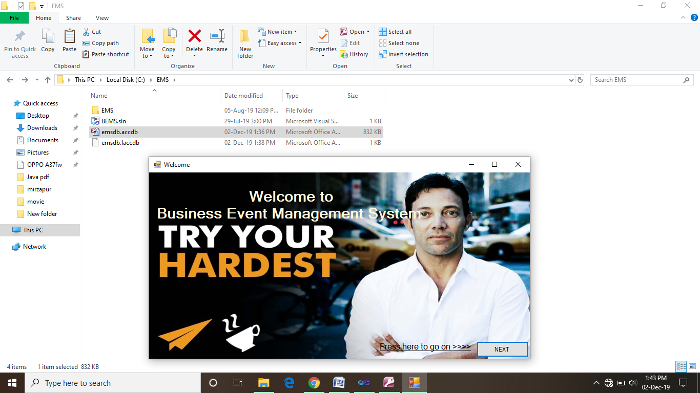
Welcome page
This is the very first Welcome window of the BEMS.
After clicking on the NEXT button we can proceed further and can enjoy the amazing features of the software.
6
BEMS/ Version 1.0

Slide 7
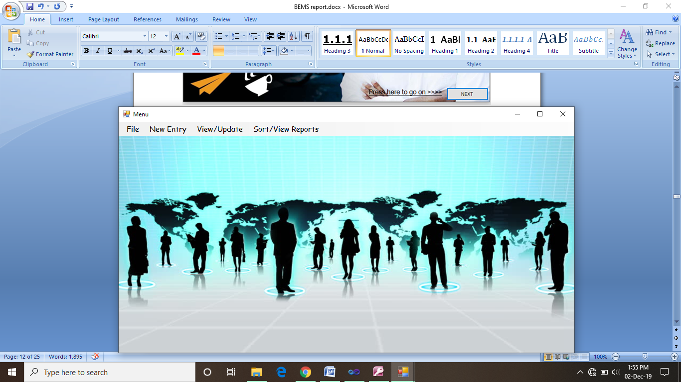
Menu
This is the Menu window in which we can perform various kinds of operations related to Managing records of a Business Event/meeting in a useful way.
Business Event Management System data base has only to Tables to manage all the data of any Kind of data i.e. prospect and team.
7
BEMS/ Version 1.0

Slide 8
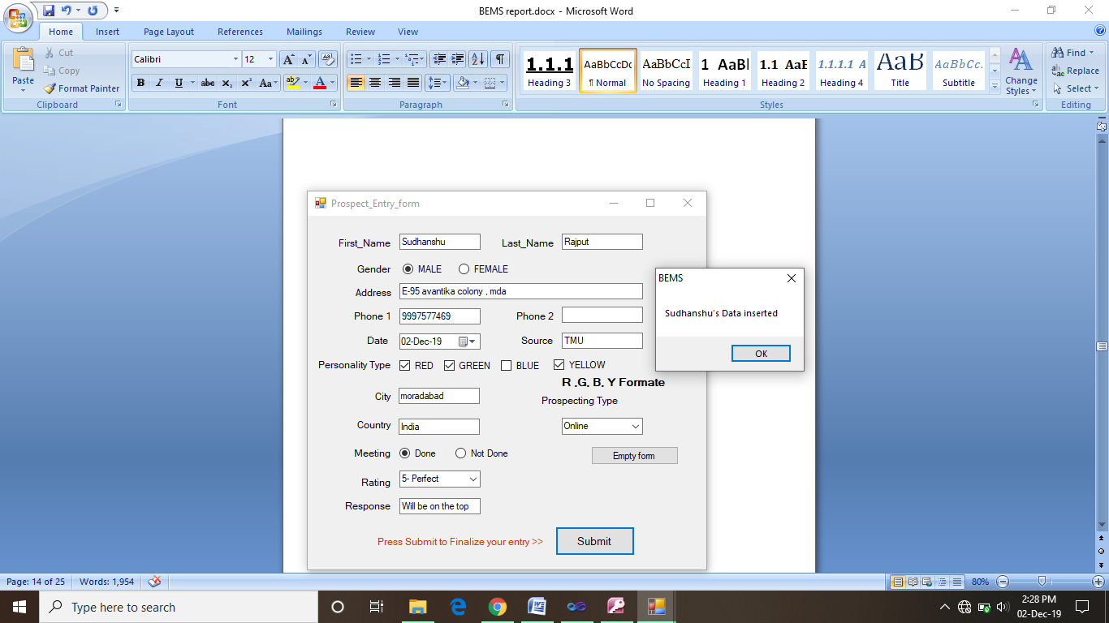
New person entry window
New Entry> prospect opens up this prospect entry form for a completely new entry. From this you can enter the all the information of a new prospect.
8
BEMS/ Version 1.0

Slide 9
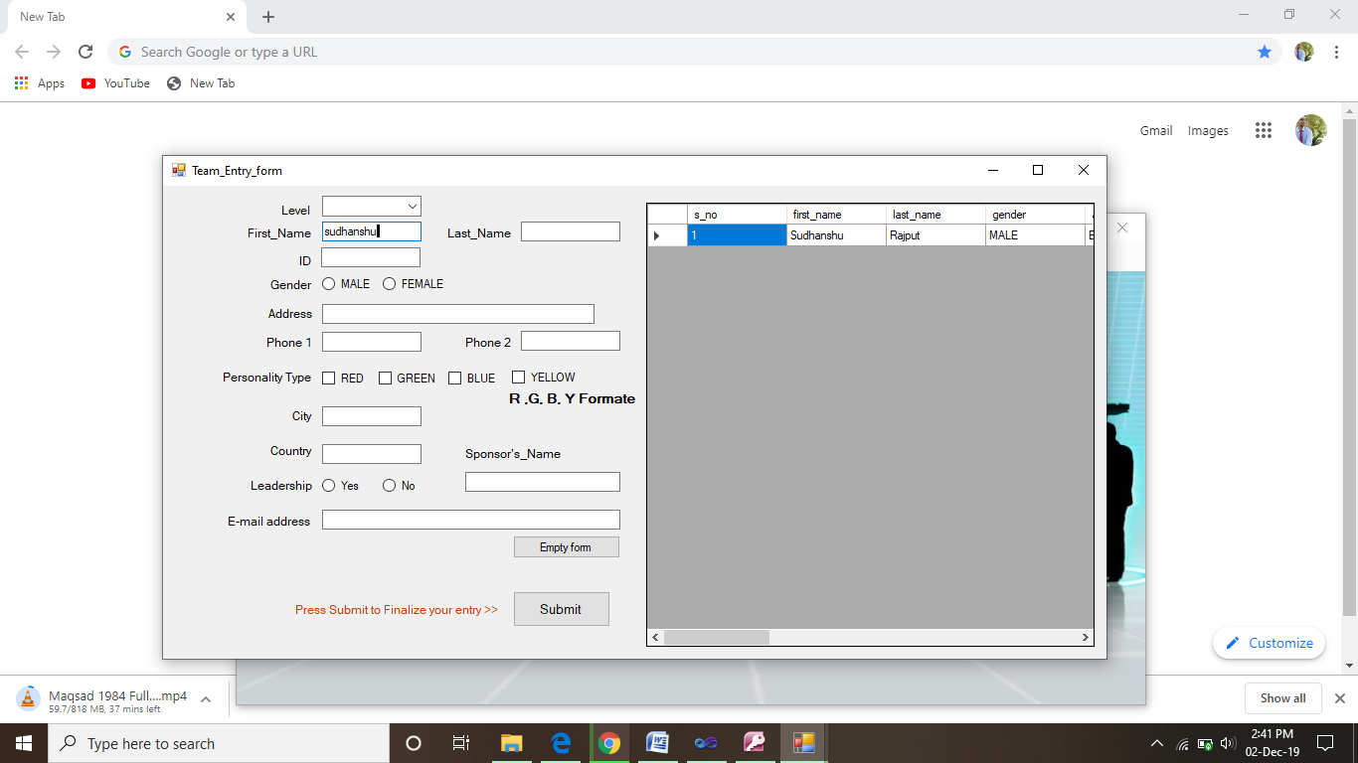
Team person entry window
New Entry> team opens up this team entry form for a completely new entry. From this you can enter the all the information of a new prospect.
9
BEMS/ Version 1.0

Slide 10
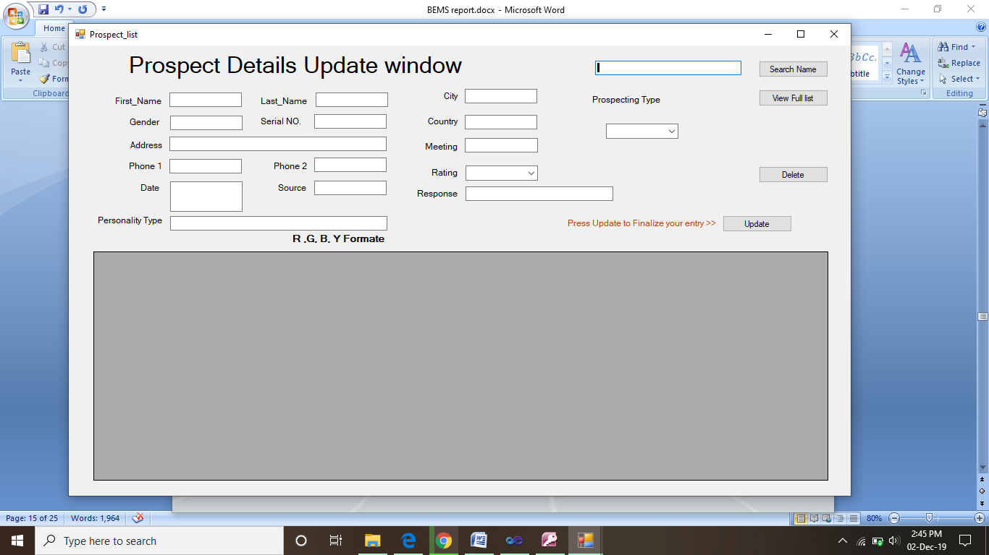
New person info. update window
View/Update> prospect list. This feature help the user to view the full list , update , delete and search a particular contact in prospect list.
10
BEMS/ Version 1.0

Slide 11
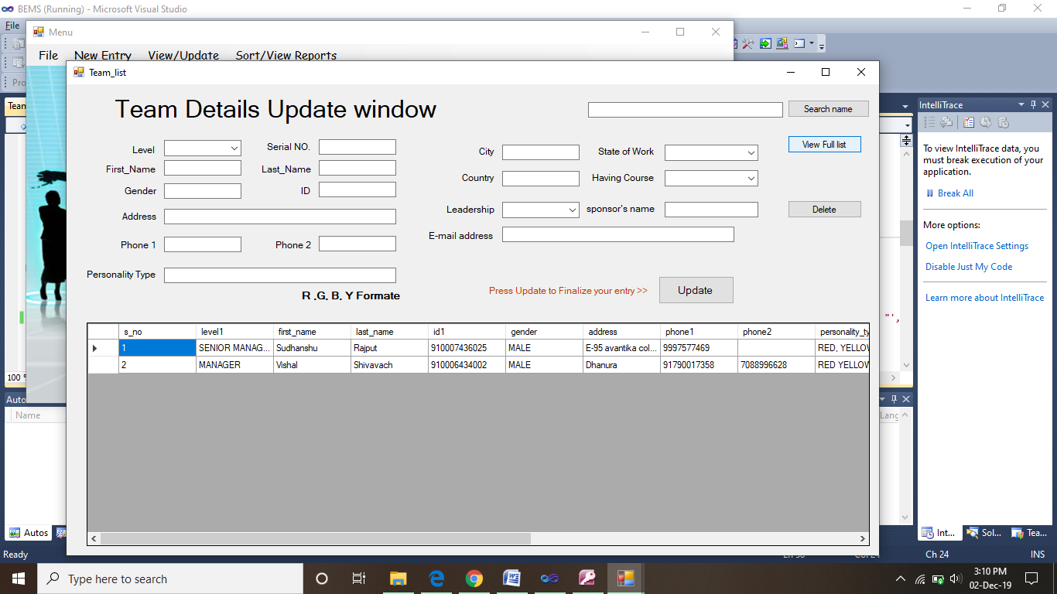
Team person info. update window
View/Update> team list. This feature help the user to view the full list , update , delete and search a particular contact in team list.
11
BEMS/ Version 1.0

Slide 12
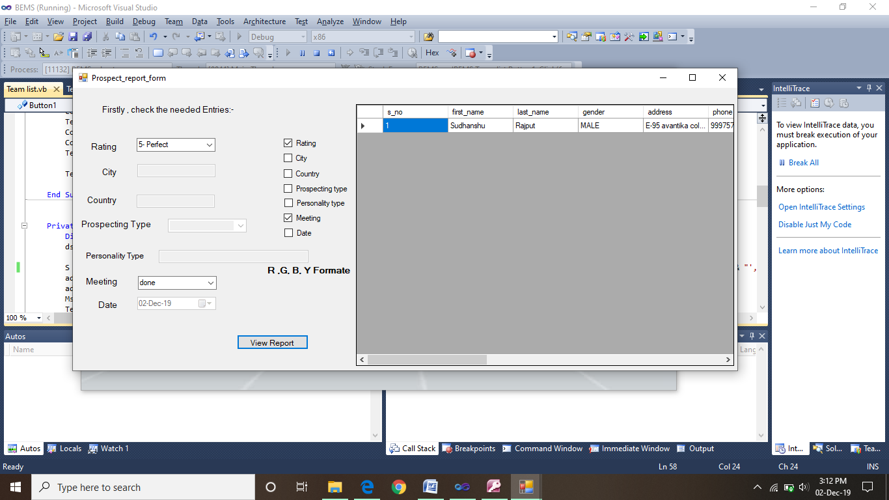
New person report generator
Sort/view reports> prospects> customizable list. This list help to user to get the prospects reports to according to its need at different instances. User can activate the option by checking the check boxes of their respective box to generate the customized reports. As shown in the above screen shot.
12
BEMS/ Version 1.0

Slide 13
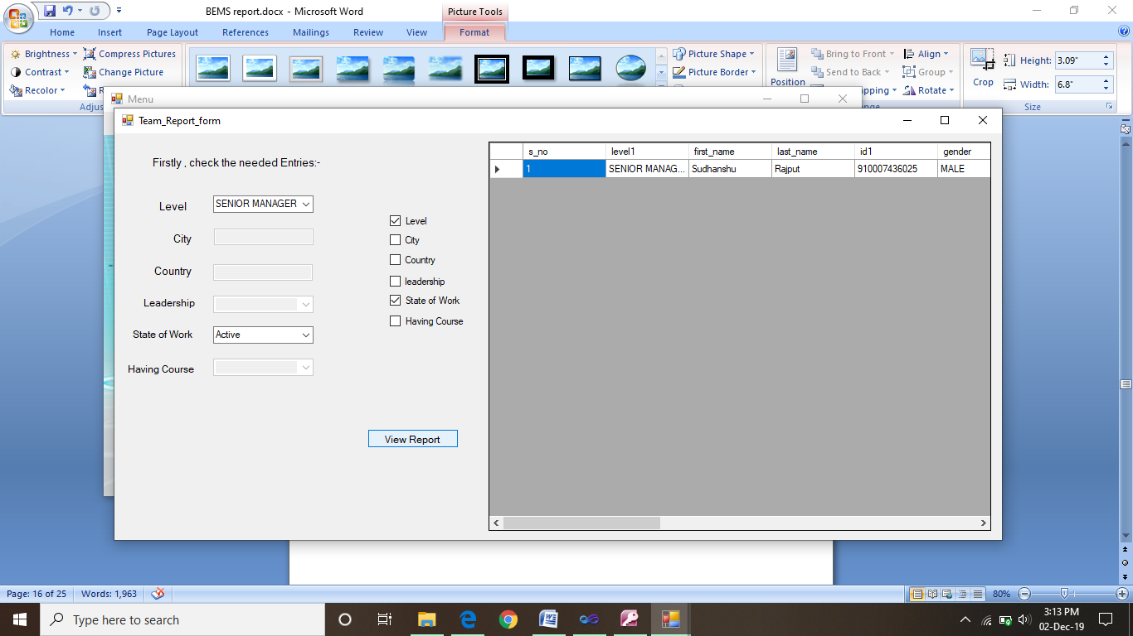
Team person report generator
Sort/view reports> team> customizable list. This list help to user to get the team reports to according to its need at different instances. User can activate the option by checking the check boxes of their respective box to generate the customized reports. As shown in the above screen shot.
13
BEMS/ Version 1.0

Slide 14
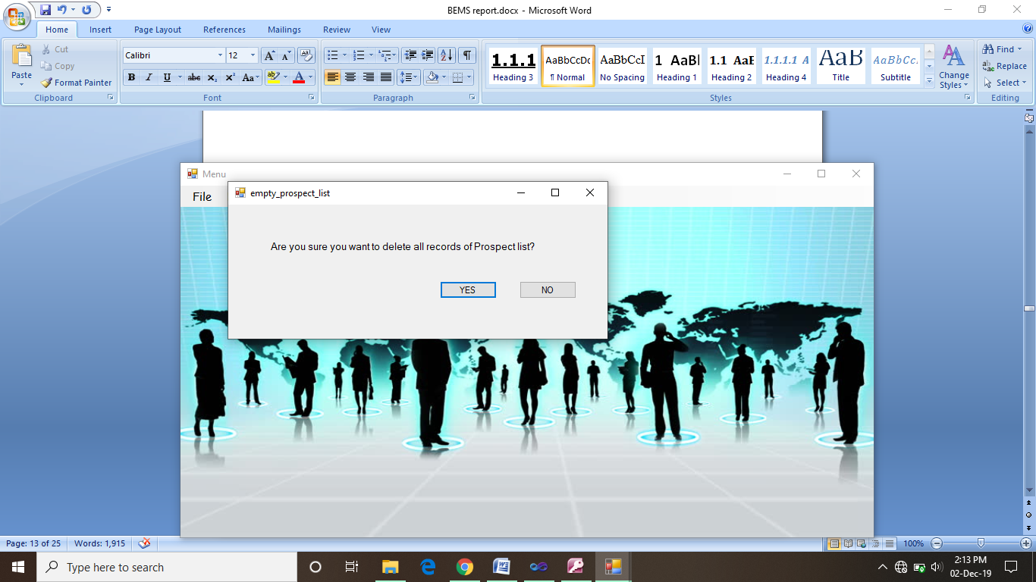
Empty prospect list window
This Empty > prospect list. Option is specially designed to clean up the database prospect table completely at once.
14
BEMS/ Version 1.0

Slide 15

Empty Team list window
This Empty > team list. Option is specially designed to clean up team table of the BEMS database completely at once.
15
BEMS/ Version 1.0

Slide 16
Advantage of The Project
This project is user friendly.
It is easy to use.
User only need to save data once in their life time.
This system can handle and sort data in fraction of seconds.
This is a memory efficient software.
This software saving our trees via reducing a lot of paper work and human effort too.
16
Guidelines: Mention advantage from this project, the audience/ users who will get benefitted

Slide 17
THANK YOU

